Slide 1
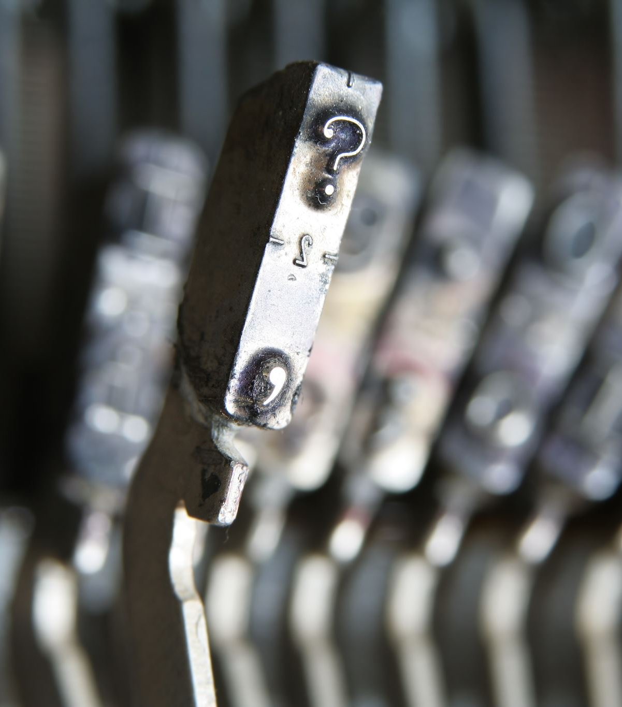
A Gentle Introduction to Extracting Text Features for Machine Learning Models using Python
Data Science Research Bazaar
University of Wisconsin, Madison
January 25, 2020

Slide 2
Text
Written or transcribed language
Academic article collection
Email inbox
Facebook feed
Course notes
Student feedback
Tweets from a bot network
Notes:
Ask folks about their personal experiences – have they worked with text before?

Slide 3
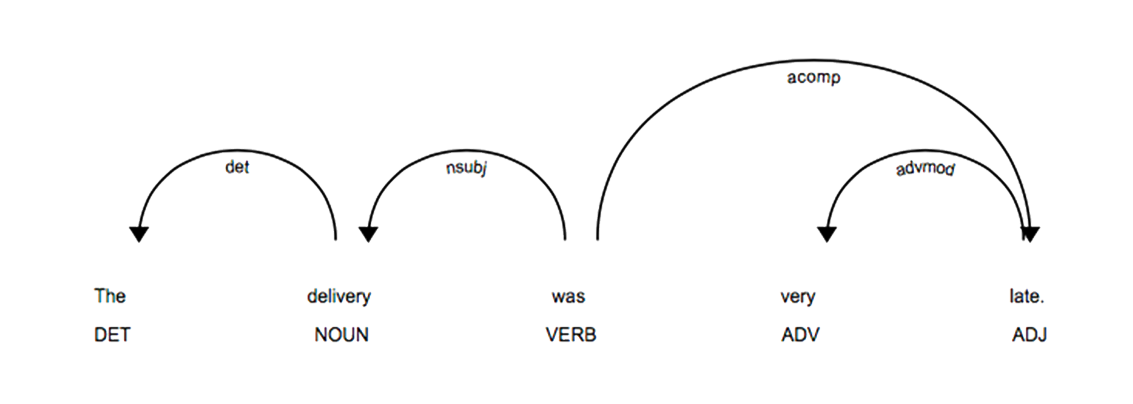
Text
Differs from many other types of data sources
Unstructured
Complex
Notes:
Ask folks about their personal experiences – have they worked with text before?

Slide 4
Text
Differs from many other types of data sources
Unstructured – in the database sense
Complex
Notes:
Ask folks about their personal experiences – have they worked with text before?

Slide 5
Text
Differs from many other types of data sources
Unstructured – in the database sense
Complex – many statistical regularities and dependencies
Similar to images, video, and audio
Notes:
Ask folks about their personal experiences – have they worked with text before?

Slide 6
Making text useful
Extracting structure from unstructured text is the central problem in text analytics and applied machine learning
Ideally, we want to
Selectively identify features that improve our models
Build models that are robust
What applications do you all have in mind?

Slide 7
Making text useful
Broadly, basic unit of analysis is a document
Single sentences → Paragraphs → Articles → Books
Want to deconstruct a document into useful components
In English, typically words or phrases
In other languages, may be parts of words (e.g. Chinese characters)
Preprocessing and feature engineering are critical

Slide 8
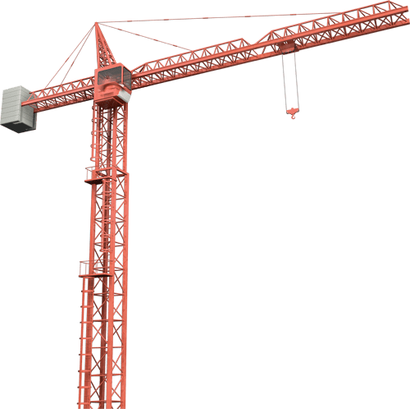

Data loading with pandas
Text data

Slide 9

Features from text: Zipf’s Law
Many words in a dataset occur very few times, or in few contexts
Some words occur in nearly every context
Nearly linear relationship between bin rank and frequency in log-log space
Zipf, G. K. (1949). Human behavior and the principle of least effort. Addison-Wesley Press.

Slide 10
Preprocessing: Capitalization
Differences in case make it hard to generalize across tokens of the same word
Example 1:
“All this happened, more or less.”
v.s. “ALl this happened...”
v.s. “aLL this happened...”
v.s. “aLl this happened...”
etc.
Zipf’s Law

Slide 11
Capitalization
In Python
my_string = "This is a sentence"
my_string.lower()
= "this is a sentence”
Can you think of cases when you might want to keep in casing information?
e.g. "Fannie May..."
Zipf’s Law

Slide 12
Preprocessing: Tokenization
Tokenization
Turning a sentence into its component parts
Words
Combinations of words
Compounds
Appropriate tokenization scheme depends on language and domain

Slide 13
Tokenization
Example 1:
“All this happened, more or less.”
Answer:
["all", "this", "happened", ",", "more", "or", "less", "."]

Slide 14
Tokenization
Example 2:
“Kurt Vonnegut Jr. was an American writer.”
Answer:
["kurt", "vonnegut", "jr.", ”was",
"an", "American", "writer", "."]

Slide 15
Tokenization
Example 3 (from Twitter):
“(if there was one you first heard, select that one & i'm also curious what general geographic location you're from, if you're comfortable with sharing!)”
Answer?
Challenges
Punctuation ("!", ")", "’")
Word splitting ("I’m" → ["I", "’m"])

Slide 16
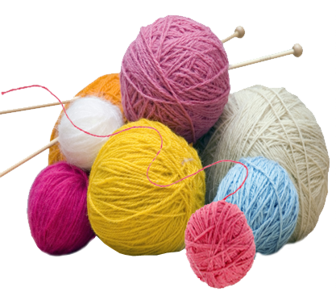
String manipulation break

Slide 17
Preprocessing: Lemmatization
Lemmatization
Reducing a word form to a more basic form
cats → cat
catting → cat
discussion → discuss
Creates less sparse text features
Reduces word to “core meaning”
Zipf’s Law

Slide 18
Preprocessing: Lemmatization
Lemmatization
Reducing a word form to a more basic form
cats → cat
catting → cat
discussion → discuss?
Zipf’s Law

Slide 19
Preprocessing: Lemmatization
Lemmatization
Reducing a word form to a more basic form
cats → cat
catting → cat
discussion → discussion?
Zipf’s Law

Slide 20
Lemmatization
Example 1:
“All this happened, more or less.”

Slide 21
Lemmatization
Example 2:
“Kurt Vonnegut Jr. was an American writer.”

Slide 22
Lemmatization
Example 3 (from Twitter):
“(if there was one you first heard, select that one & i'm also curious what general geographic location you're from, if you're comfortable with sharing!)”

Slide 23
Problems caused by lemmatization
Lemmatized words lack structural information
e.g. “walks” and “walked” do not mean the same thing
Not always a clear decision about parts
”antiestablishmentist” → ??
For some downstream tasks it results in major loss of information
English-centric

Slide 24
Preprocessing: Stemming?
Stemming uses regular expressions to deterministically trim off word endings in English
walking → walk
digging → digg

Slide 25
String manipulation break

Slide 26

Preprocessing: Stop words
Words that mean little on their own (e.g. “is”, “the”, “would”), typically the highest frequency words
Removal of stop words is highly useful for information retrieval
Stop words contribute little to search success – searches are typically content words
Practical use in most applied contexts is unclear

Slide 27
Preprocessing: Stop words
Reasons to keep stop words:
No hard cutoff for what counts as a stop word
Highly predictive in some tasks (e.g. authorship recognition)
Useful for building more complex (e.g. n-gram) models

Slide 28
Preprocessing: Rare and unseen words
Very low-frequency words can pose problems
Can very quickly expand the number of features
Zipf’s Law
60,000 words with a frequency < 7

Slide 29
UNK tokens
Solution to low-frequency words: Replace them with an “UNK” token
BEFORE: 'provides a porthole into that noble , trembling incoherence that defines us all .'
AFTER: 'provides a UNK into that noble , trembling UNK that defines us all .'

Slide 30
String manipulation break

Slide 31
Interim: Best practices
Tokenize your text into its basic components
Optionally:
Make documents lower-case (casing)
Simplify words into their bases (lemmatize)
Remove high-frequency words (stop words)
Substitute low-frequency words for a placeholder (UNK)

Slide 32

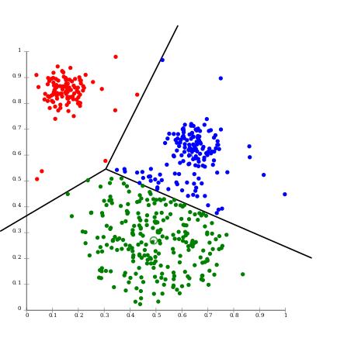
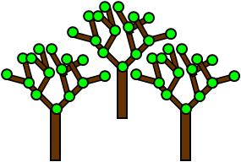
From strings to vectors
Fundamental unit of machine learning models is the vector
An ordered list of values
Vectors of text-based features can be used in any machine learning model
Decision trees and random forests
Nonparametric methods (e.g. k-means)
Linear models

Slide 33
Today’s example: Rotten Tomatoes reviews
http://www.cs.cornell.edu/people/pabo/movie-review-data/
Task involves sentiment categorization
Negative ←→ Positive
Ordinal (1/2/3/4/5) or categorical (positive, somewhat positive...)
What kind of review is the one below?
“Interesting, but not compelling.”
What about this one?
“If you sometimes like to go to the movies to have fun, Wasabi is a good place to start.”

Slide 34
An application: Text classification
Task: Take unstructured text and predict a label
Today’s dataset: Rotten Tomatoes reviews
http://www.cs.cornell.edu/people/pabo/movie-review-data/
Documents are single movie reviews containing multiple sentences
Is a given document a positive or negative review?

Slide 35
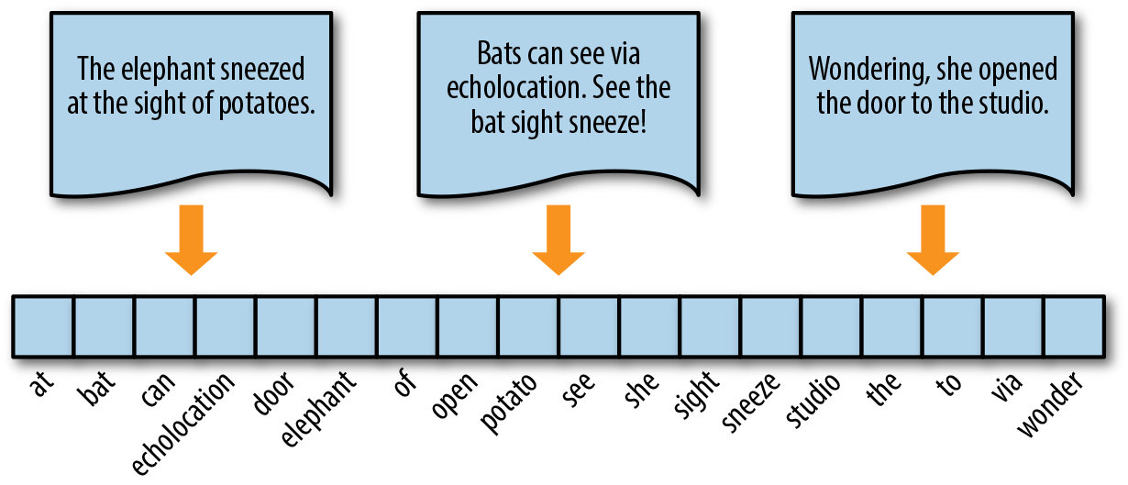
Features from text: Bag-of-words
Credit: https://www.oreilly.com/library/view/applied-text-analysis/9781491963036/ch04.html

Slide 36
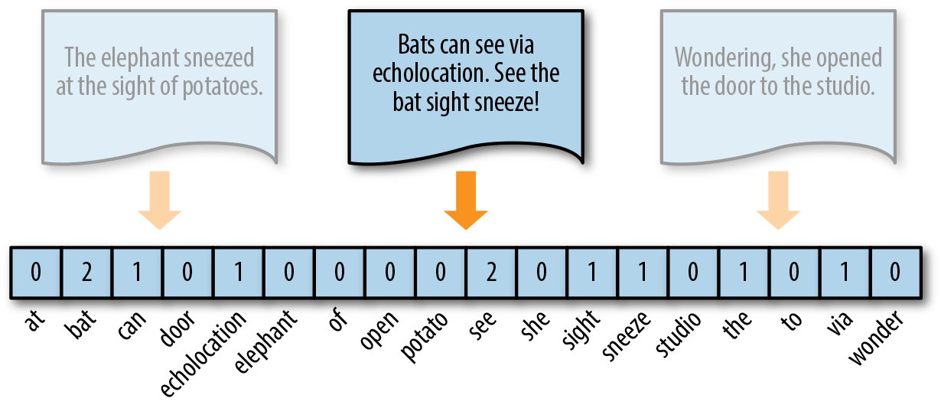
Features from text: Bag-of-words
Credit: https://www.oreilly.com/library/view/applied-text-analysis/9781491963036/ch04.html

Slide 37

Creating bag-of-words features
CountVectorizer in sklearn
Creates a sparse matrix of counts of each word in a set of documents

Slide 38
Creating bag-of-words features
from nltk.tokenize import word_tokenize
from sklearn.feature_extraction.text import CountVectorizer
counts = CountVectorizer(
min_df=1, tokenizer=word_tokenize,
stop_words=None).fit_transform(
my_list_of_documents)

Slide 39
Features from text
Downsides to the bag-of-words approach
Missing word order (“baby monkey” and “monkey baby” do not mean the same thing)
Doesn’t capture broader context (“not the best” vs. “best”)
Learning objective be expensive or unstable at high dimensionalities
Long data
Wide data

Slide 40
Bag-of-words demo

Slide 41
Features from text: Alternate ways of counting
Term frequency / Inverse document frequency (TF-IDF)
Term frequency
Number of times a word occurs in a document
Document frequency
Number of documents where a word is seen at least once

Slide 42
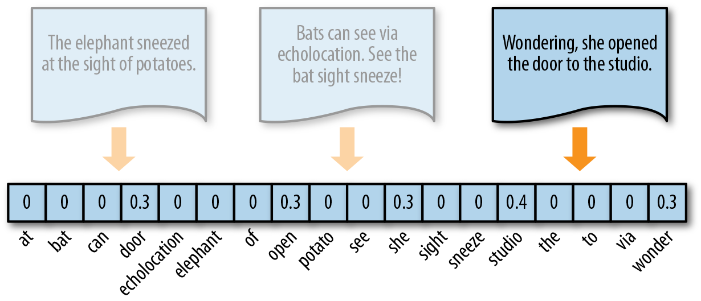
Features from text: TF-IDF
Credit: https://www.oreilly.com/library/view/applied-text-analysis/9781491963036/ch04.html

Slide 43
Creating TF-IDF features
from nltk.tokenize import word_tokenize
from sklearn.feature_extraction.text import CountVectorizer
counts = CountVectorizer(
min_df=1, tokenizer=word_tokenize,
stop_words=None).fit_transform(
my_list_of_documents)
def IDF(counts_, smooth=1):
counts_[counts_ > 0] = 1 # insensitive to repetition
smoothed_counts = counts_.sum(axis=0) + smooth
idf = counts.shape[0] / smoothed_counts
return idf

Slide 44
Creating TF-IDF features
Once you have counts and IDF values, obtaining TF-IDF scores is a multiplication problem
Counts contain “term frequencies” (the TF part)
Multiply each row in the original count matrix by the new IDF vector to get a TF-IDF matrix
counts.multiply(IDF(counts))
Optionally, log transform:
np.log(counts.multiply(IDF(counts)))

Slide 45
TF-IDF demo

Slide 46
Features from text: N-grams
N-gram features are sequences
Multiple letters (for representing words)
Multiple words (for representing phrases)
Capture some contextual information about word use

Slide 47
N-grams
N-gram features

Slide 48
N-grams
Shortcomings to n-grams

Slide 49
N-grams demo

Slide 50
Word embeddings
Shortcomings to matching on exact words and exact context
For many applications, we are not concerned about exact matches
e.g. “horrible” and “worst” are both negative words
Intuitively, similar words occur in similar types of documents
Two clusters of words that occur with the word “winter”

Slide 51
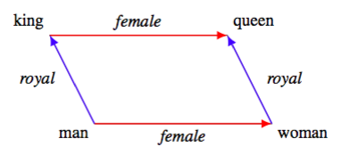
Word embeddings
Making wide sparse count matrix into a narrow and dense one
Dimensionality reduction approach
e.g. Latent Semantic Analysis
Steps:
Compute bag-of-words representations
Use principle components analysis (PCA) or related method and project into a lower-dimensional space
Landauer & Dumais (1997) Psychological Review

Slide 52
Word embeddings
Latent dimensions can be difficult to interpret
1 | 2 - Top | 2 - Bottom | 32 | 72
bad | the | unk | i | can
worth | , | de | but | more
funny | of | que | by | most
entertaining | to | y | on | will
too | is | la | like | only
comedy | and | ‘ | from | their
boring | it | an | -- | up
fun | . | o | movie | director
should | in | es | for | they

Slide 53
Latent Semantic Analysis demo

Slide 54
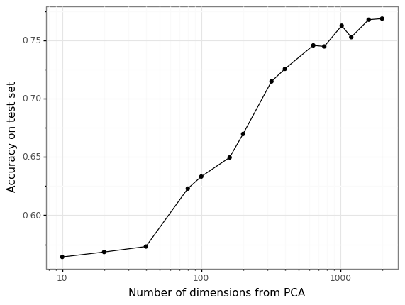
Word embeddings
Latent Semantic Analysis
Model performance improves with more features but levels off at ~1000
Very little performance loss relative to bag-of-words
Landauer & Dumais (1997) Psychological Review

Slide 55
Word embeddings
Other embeddings approaches
word2vec
GloVe
Embeddings available off-the-shelf
Stanford GloVe: Wikipedia 2014 + Gigaword 5 (6B tokens, 400K vocab, uncased, 300d vectors): glove.6B.zip
vsmlib resources contain pre-trained models, incl. word2vec

Slide 56
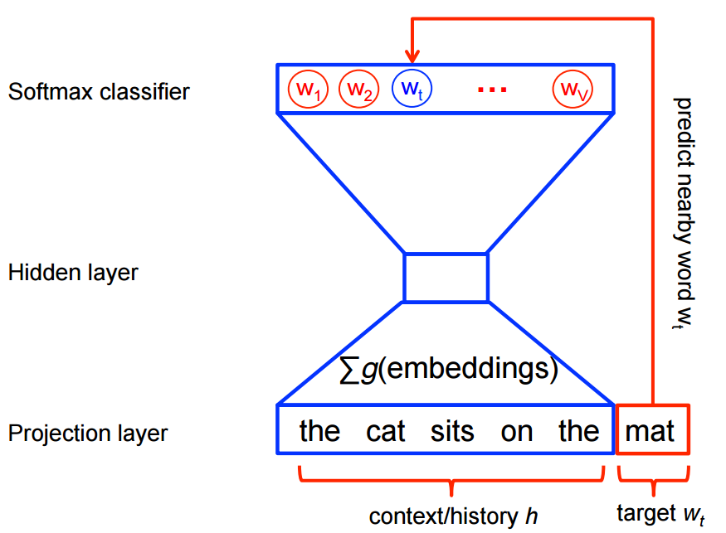
word2vec
Algorithm developed by Google
Uses prediction to learn word meanings
How to aggregate all words in the sentence is a puzzle
Common solution is to use tf-idf to weight pre-trained word vectors
Mikolov, T., Sutskever, I., Chen, K., Corrado, G. S., & Dean, J. (2013). In Advances in Neural Information Processing Systems (pp. 3111-3119).

Slide 57
word2vec
TF-IDF weighting on word vectors in vocab of size |V|
Scales impact of each word
Three components:
word2vec vectors
bag-of-words vectors
IDF weighting
word2vec * TF * IDF
Mikolov, T., Sutskever, I., Chen, K., Corrado, G. S., & Dean, J. (2013). In Advances in Neural Information Processing Systems (pp. 3111-3119).

Slide 58
Word embeddings
Bonus exercise: Look ma, no feature engineering!

Slide 59
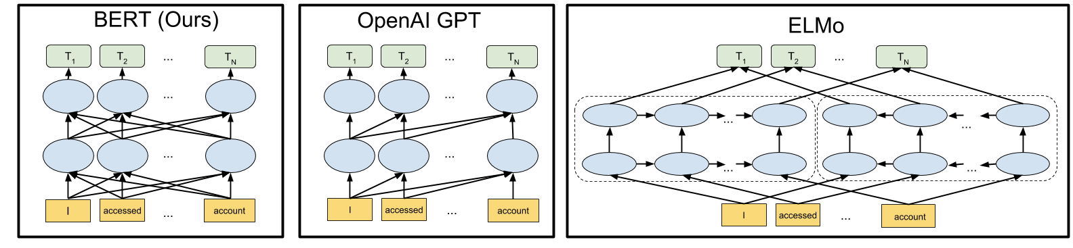
Sentence embeddings with transformers
These models are very large, very complex, and very slow
Nevertheless, performance gains can be substantial
BERT and other context-sensitive models use the entire document (e.g. a sentence) to create sets of vectors
https://ai.googleblog.com/2018/11/open-sourcing-bert-state-of-art-pre.html

Slide 60
Transformers (BERT) demo

